Slide 1
Describe a person

Slide 5
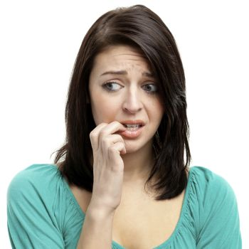

Slide 6
