Slide 1
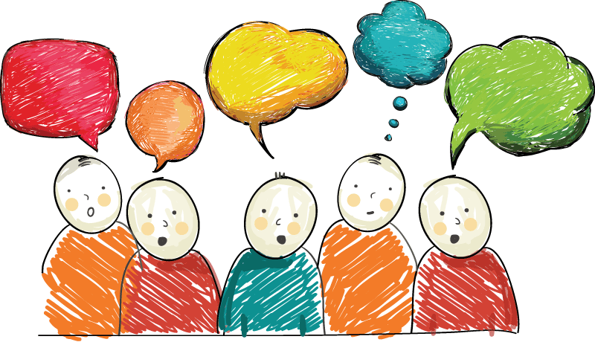
Opinion Adjectives

Slide 2
Fantastic

Slide 3
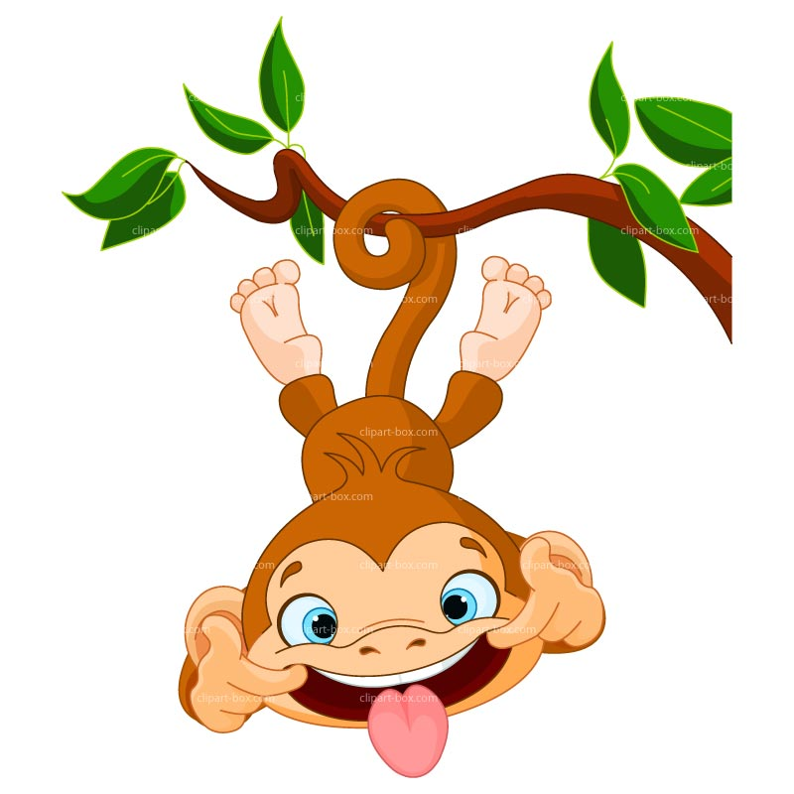
Funny

Slide 4
Terrible

Slide 5
Exciting

Slide 6
Boring

Slide 7
Interesting

Slide 8
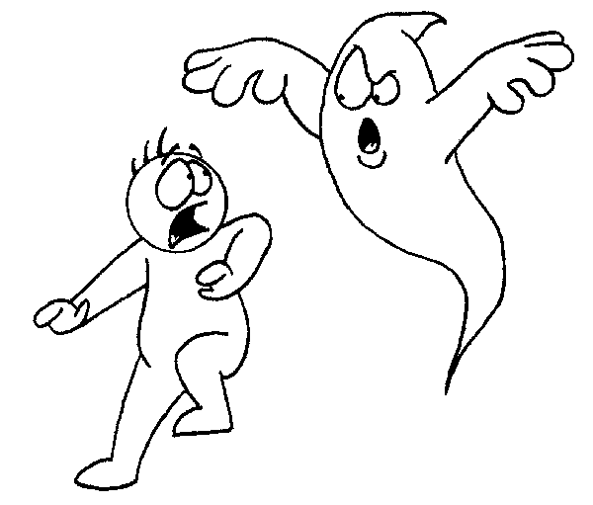
Scary

