Slide 1
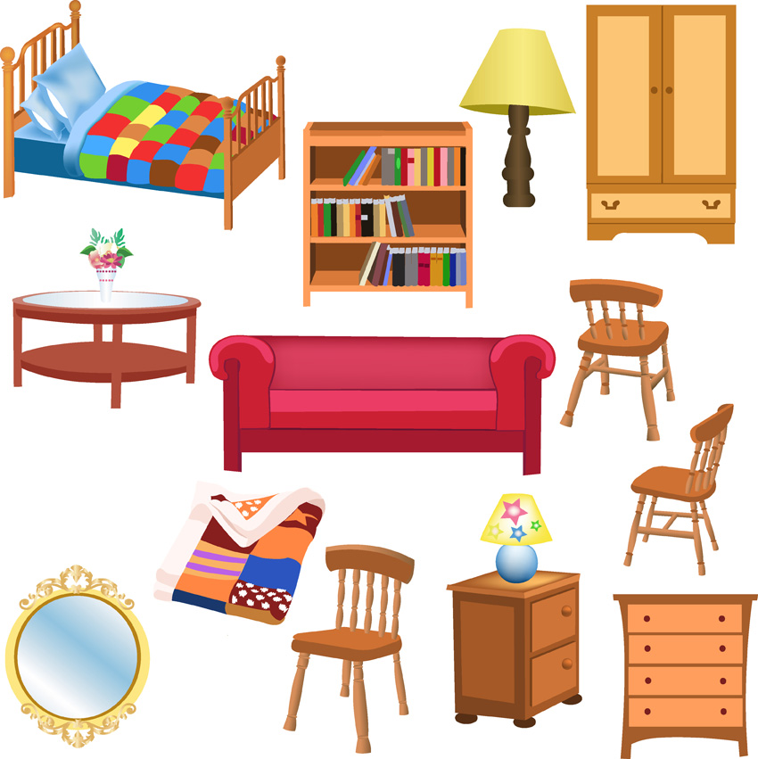
Furniture

Slide 2
Desk

Slide 3
Bookcase

Slide 4
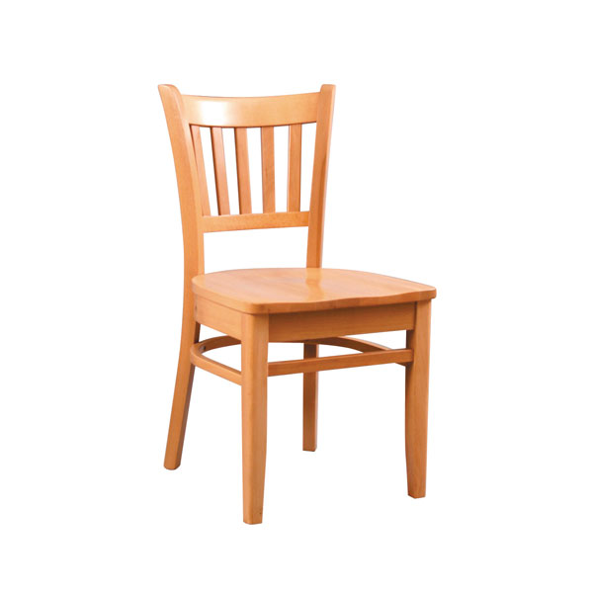
Chair

Slide 5
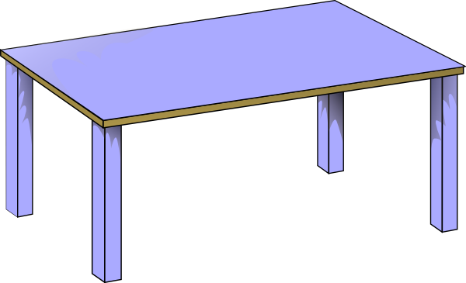
Table

Slide 6
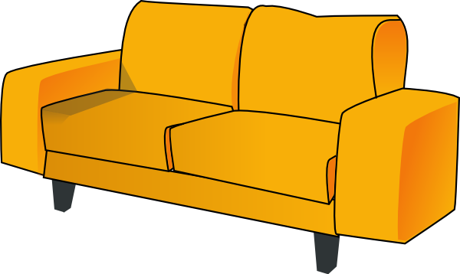
Sofa

Slide 7
Mirror

Slide 8
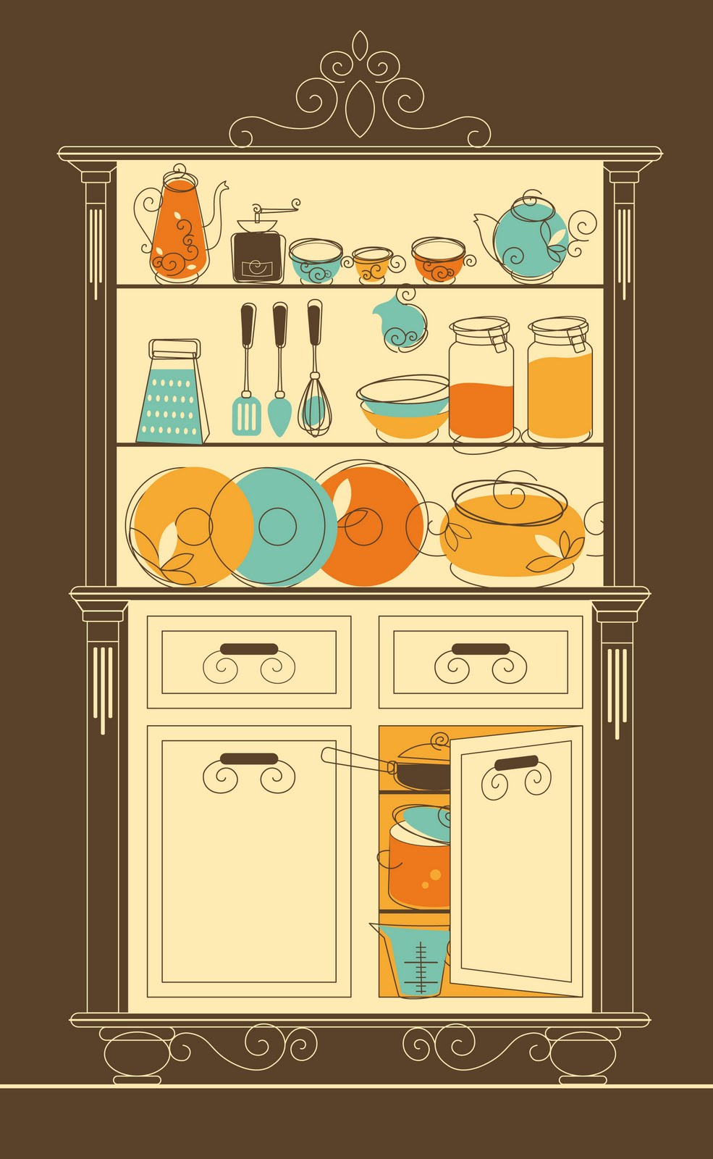
Cupboard

Slide 9
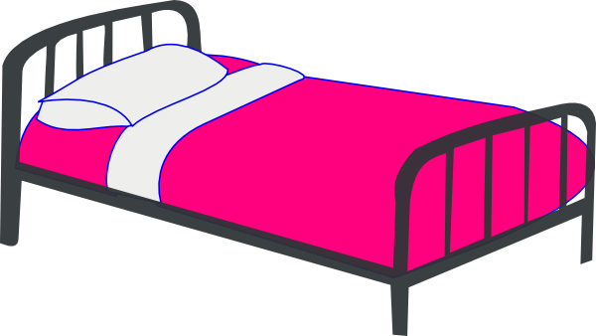
Bed

Slide 10
Bath

Slide 11
Toilet

Slide 12
Shower

Slide 13
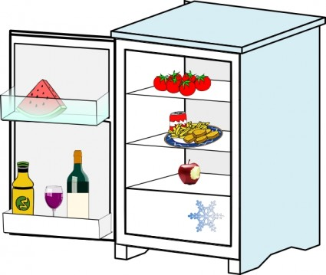
Fridge

