Slide 1
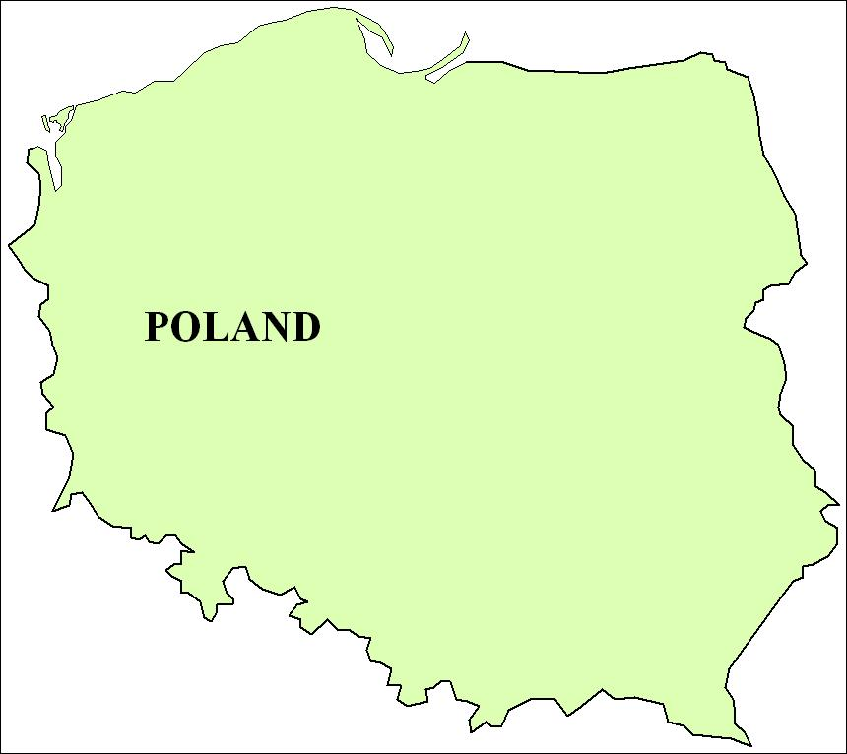
Where is Poland?
It`s here!

