Slide 1
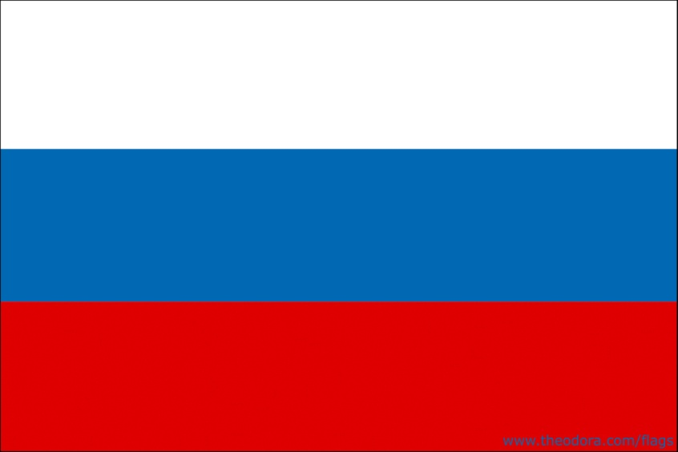
Where are you from?
I am from Russia.

