Slide 1
We`re scouts

Slide 2
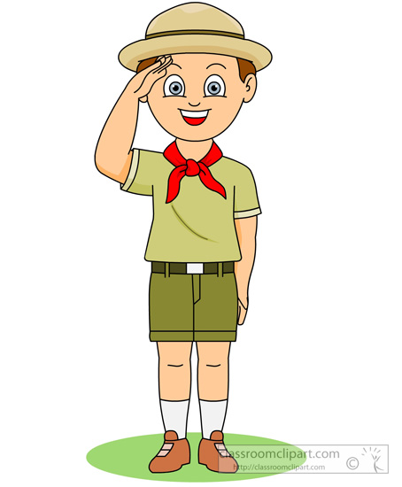
Scout

Slide 3
Badges

Slide 4
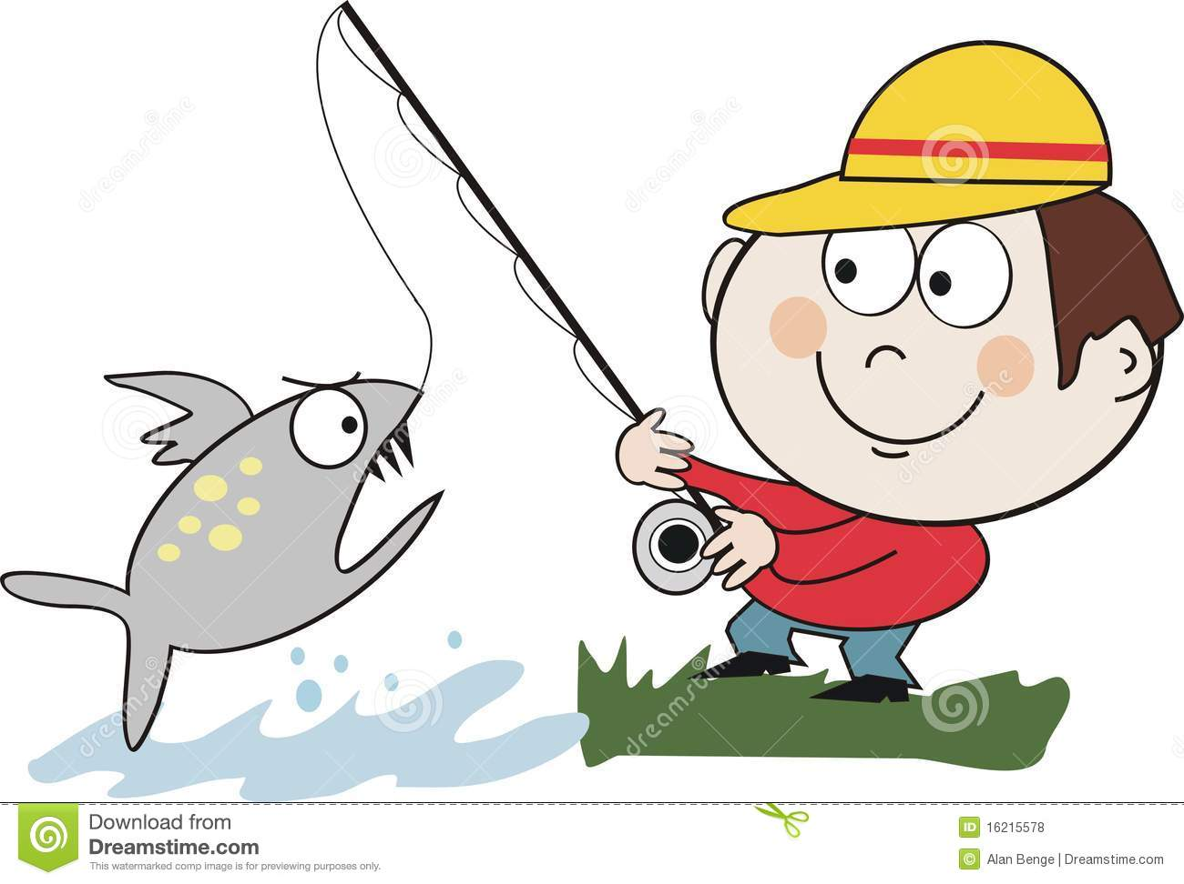
Catch a fish

Slide 5
Sail

Slide 6
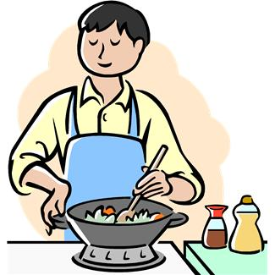
Cook

Slide 7
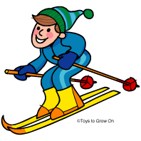
To ski

Slide 8
Swim

Slide 9
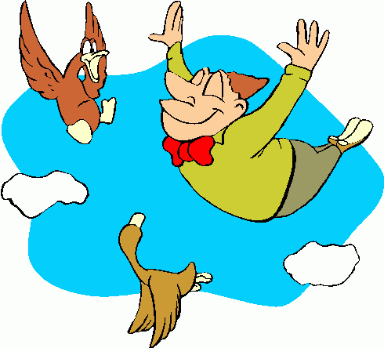
Fly

Slide 10
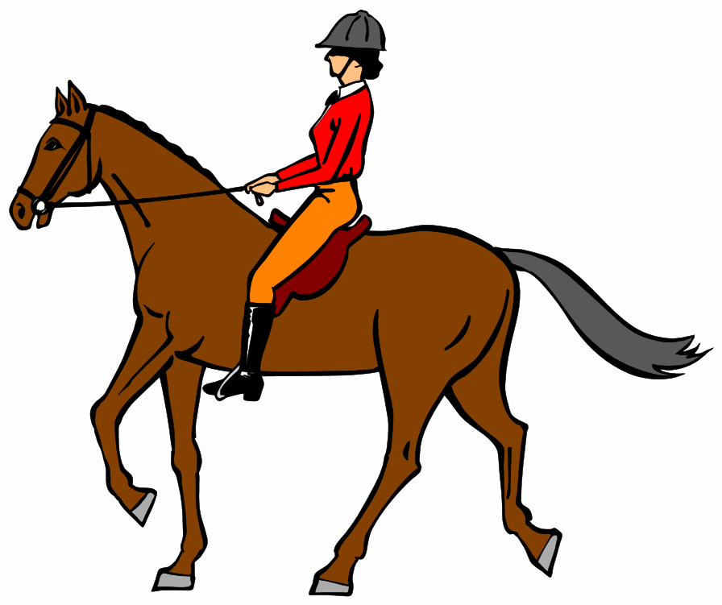
Ride a horse

Slide 11
In this text we can see …
This text is about …

