Slide 1
Summer fun

Slide 2
Sun

Slide 3
Sunglasses

Slide 4
Boat

Slide 5
Umbrella

Slide 6
Towel

Slide 7
Picnic

Slide 8
Sun cream

Slide 9
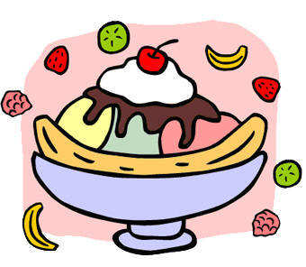
Ice cream

