Slide 1
Russia

Slide 2
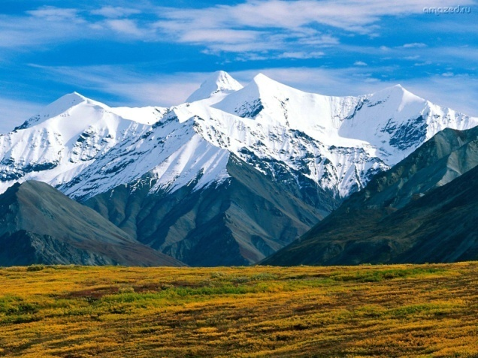
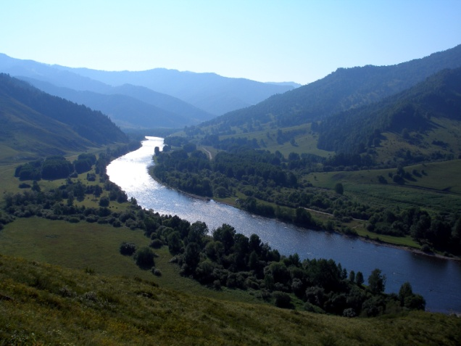
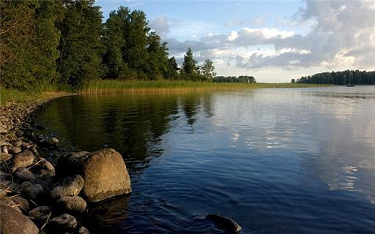
Rivers:
the Volga
the Ob
the Yenisei
the Lena
the Amur
Mountains:
the Urals
the Caucasus
the Altai
Lakes :
Lake Baikal
Lake Ladoga
Lake Seliger

