Slide 1
Describe people

Slide 4
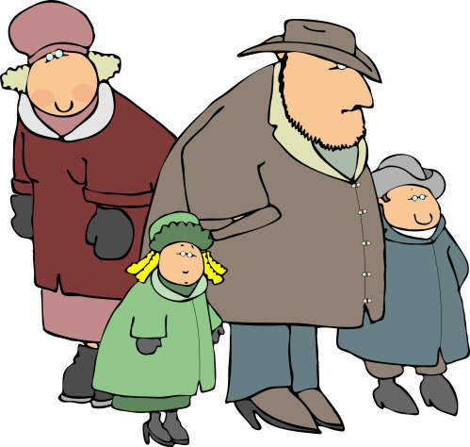

Slide 7
