Slide 1
Look and guess
Furniture

Slide 2
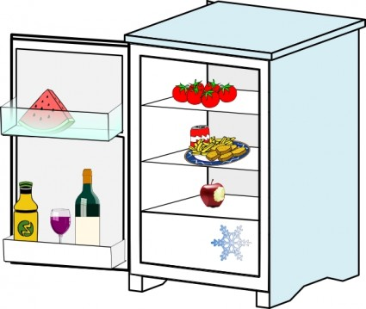

Slide 3
