Slide 1
St. Valentine's Day

Slide 2
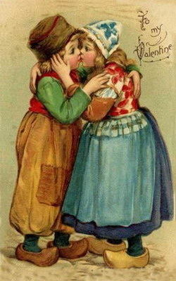
Greetings
Happy Valentine’s Day!
To my Valentine!
I’m sending you a Valentine’s Wish filled with Hugs and Kisses

