Slide 1
Stop!

Slide 3
Hurry!

Slide 4
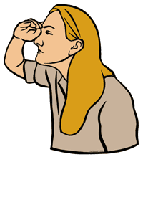
Look

Slide 5
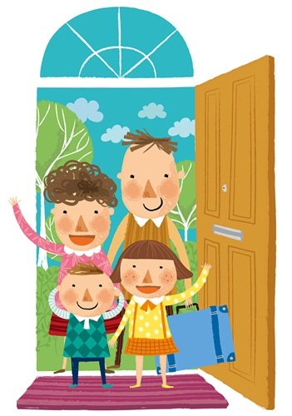
Arrive

Slide 6
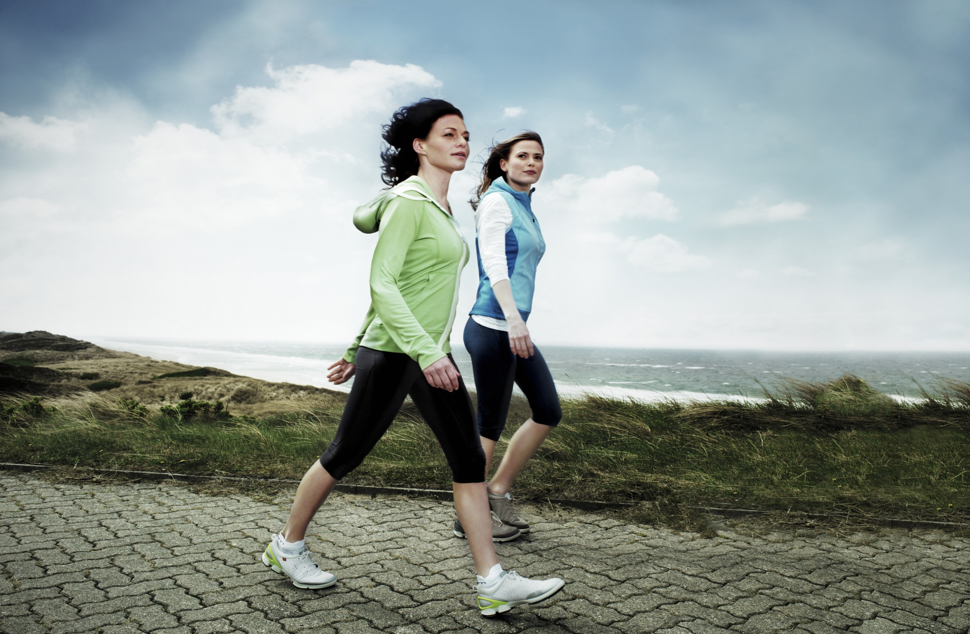
Walk

