Slide 1
Entertainment

Slide 2
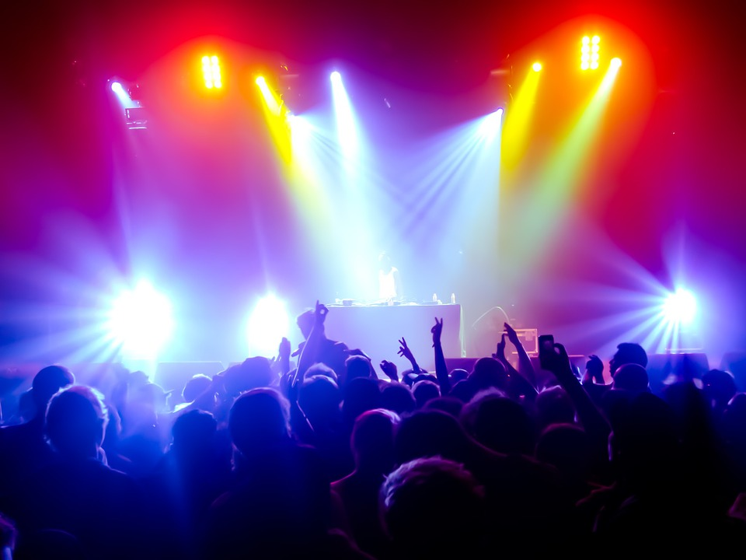
Concert

Slide 3
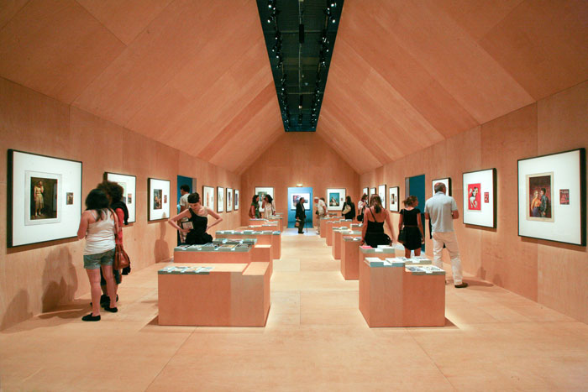
Exhibition

Slide 4
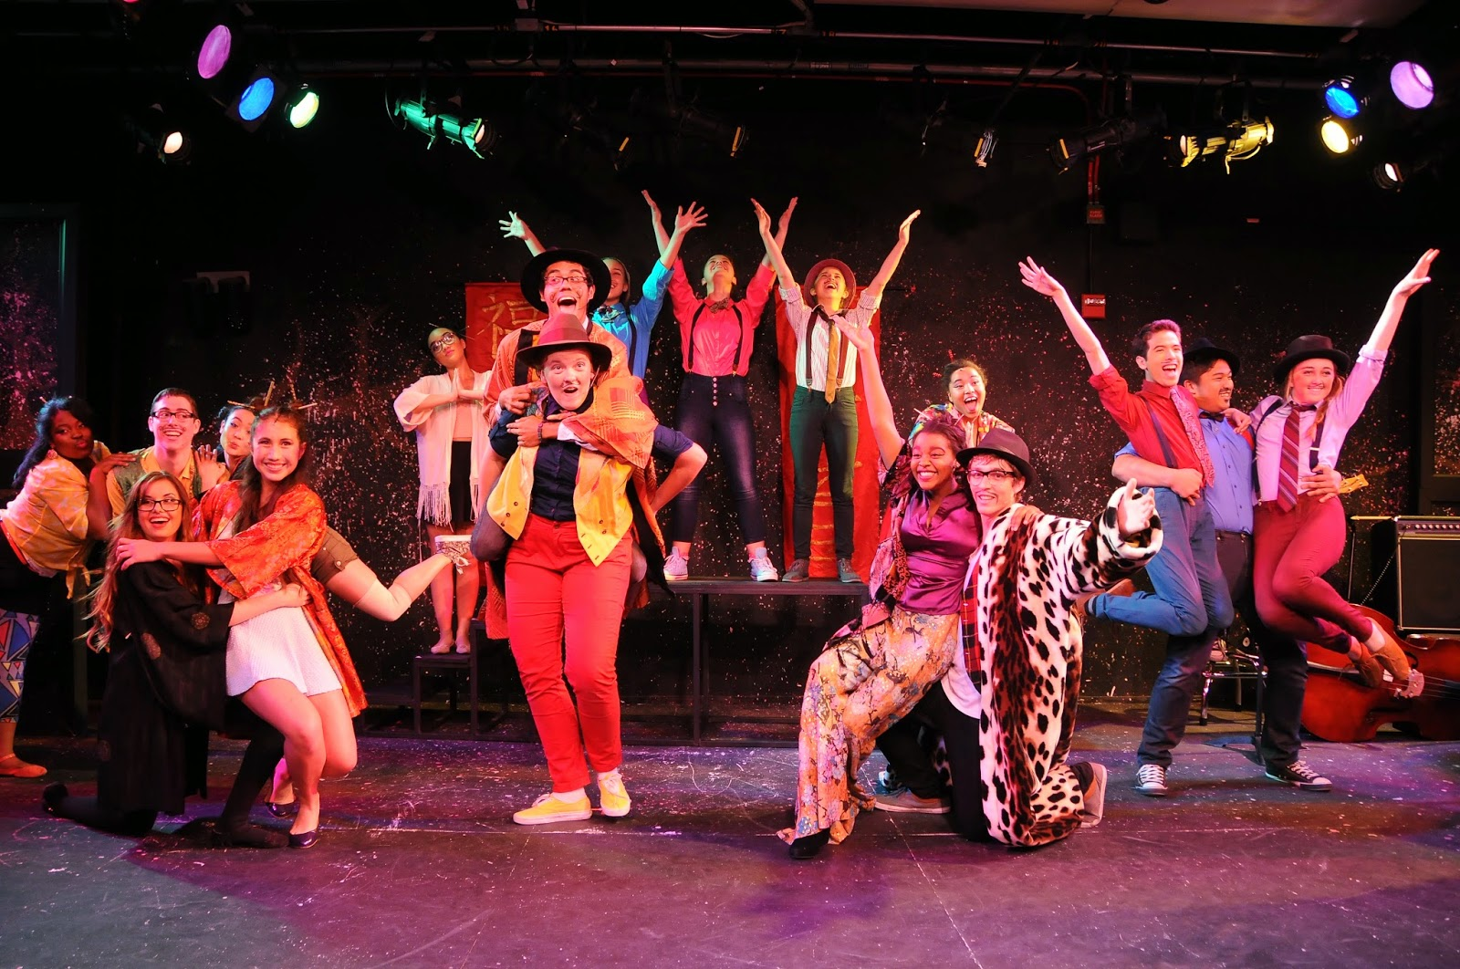
Musical

Slide 5
TV programme

Slide 6
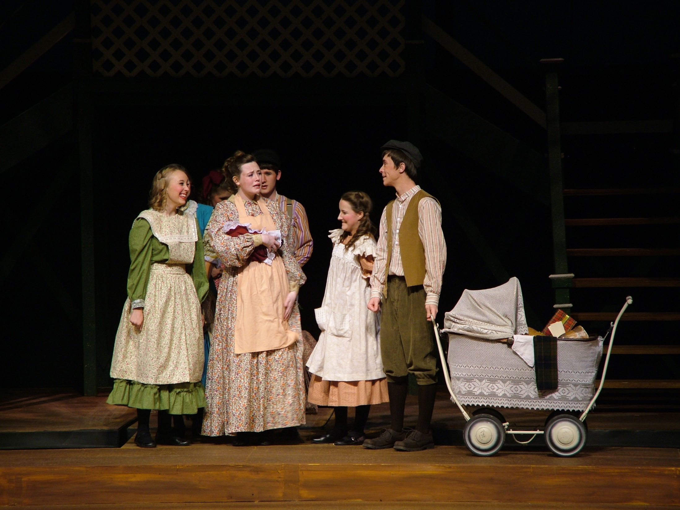
Play

Slide 7
Film

