Slide 1
Countries

Slide 2
Portugal

Slide 3
Argentina

Slide 4
Turkey

Slide 5
Greece

Slide 6
China

Slide 7
Australia

Slide 8
The USA

Slide 9
Britain

Slide 10
Poland

Slide 11
Egypt

Slide 12
Brazil

Slide 13
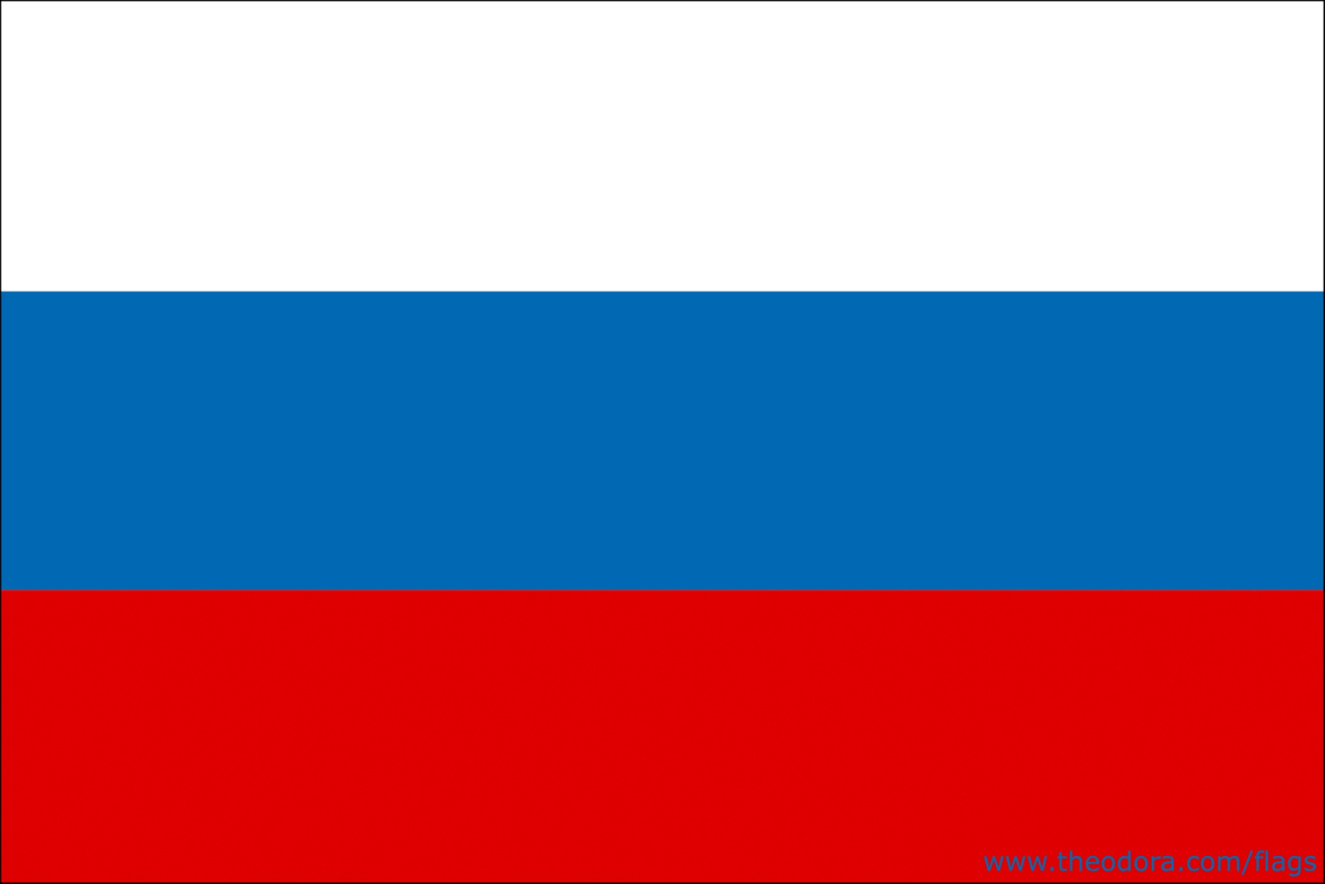
Russia

Slide 14
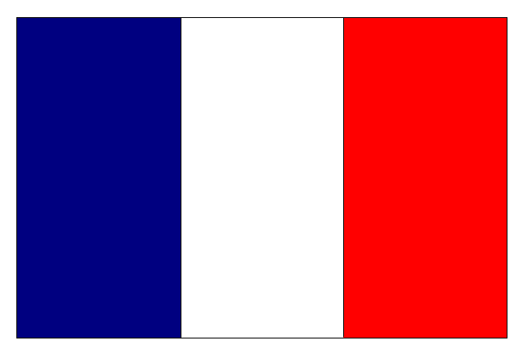
France

Slide 15
Germany

