Slide 1
Russia

Slide 2
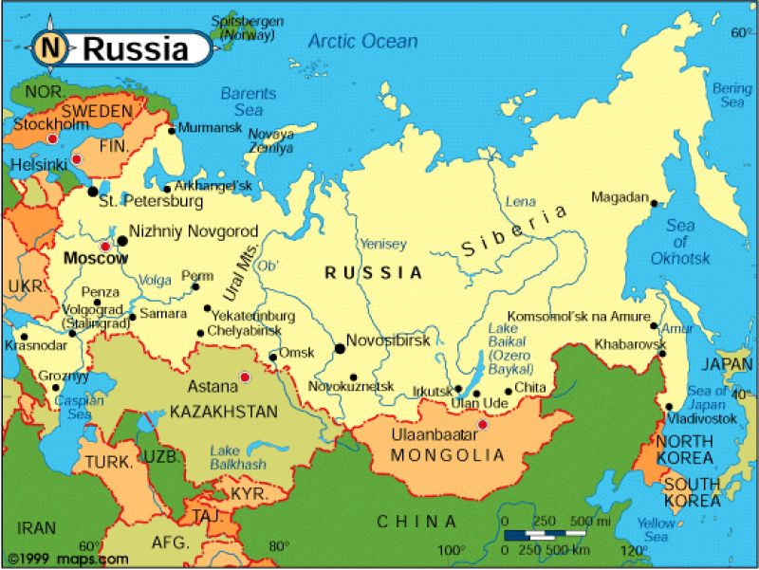

Slide 3
