Slide 1
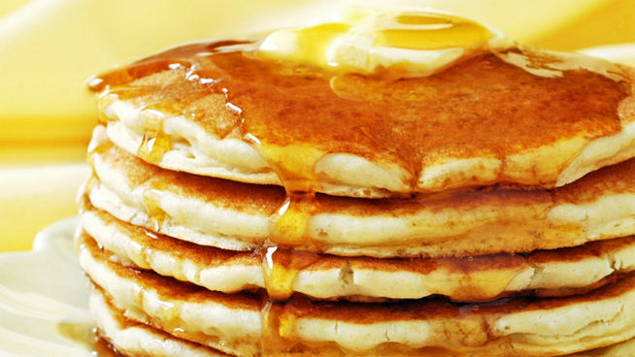
Pancake day

Slide 2
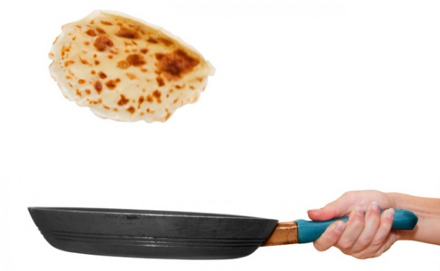

Slide 3
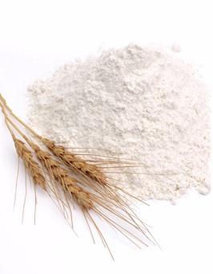
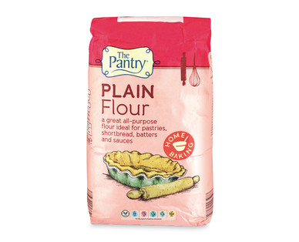
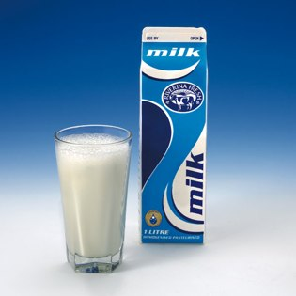
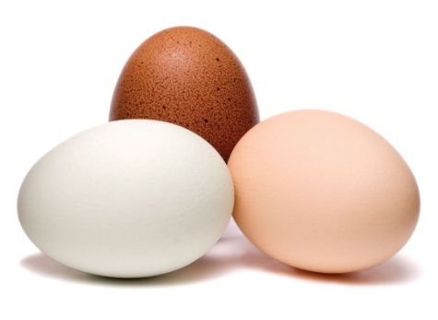
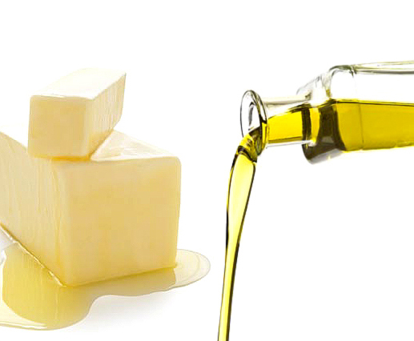
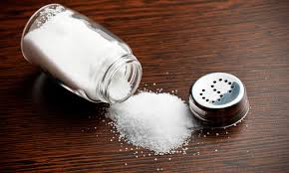
Ingredients
Plain flour
Milk
Eggs
Butter /oil
Salt

Slide 4
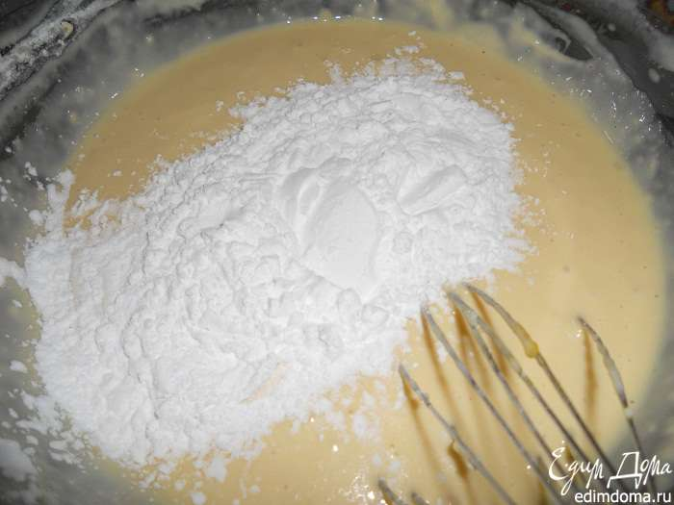
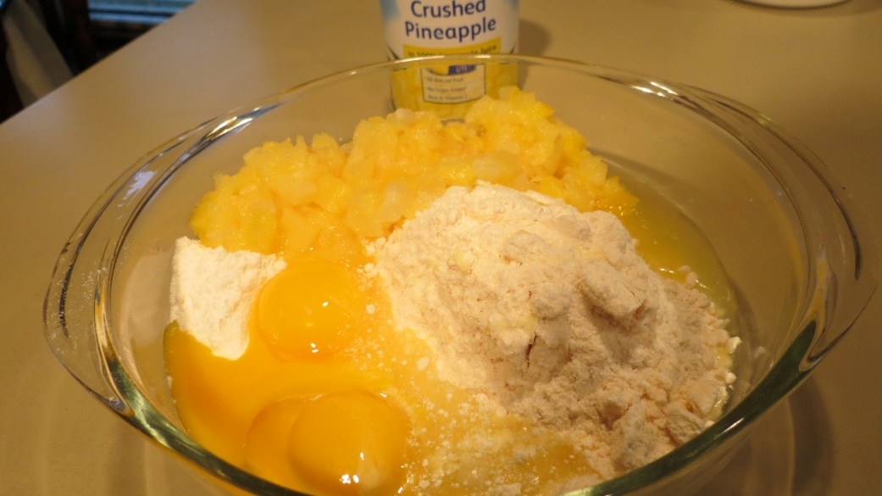
Mix the flour and milk
Add eggs

Slide 5
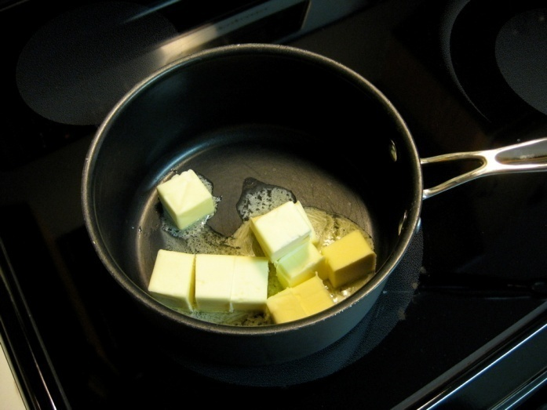
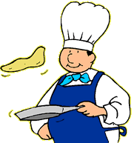
Heat the butter
Toss the pancake

Slide 6
Order the recipe
Toss the pancake
Heat the butter
Add the milk
Mix the flour and the salt
Add lemon and sugar
Cook the pancake
Mix the flour, eggs and milk
Add the eggs

Slide 7
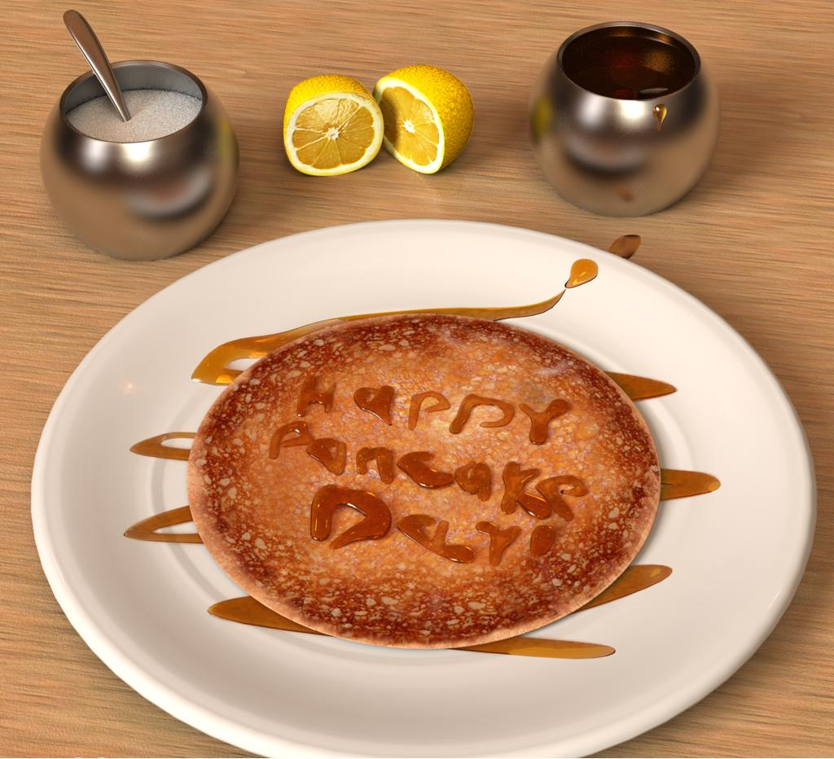
Mix the flour and the salt
Add the eggs
Add the milk
Mix the flour, eggs and milk
Heat the butter
Cook the pancake
Toss the pancake
Add lemon and sugar

Slide 8
Create your recipe
Ice cream
Salad
Chicken and rice
Hot chocolate

