Slide 1
Happy New Year

Slide 2
Riddles
1) It’s time when is snowing, when all children do skating, skiing, make snowmen and play snowballs.
Winter
Autumn
Spring
Summer

Slide 3
Riddles
2) We celebrate it on the first of January.
New Year
St. Valentine`s day
Independent day

Slide 4
Riddles
3) He always comes in the night of New Year and brings presents to obedient boys and girls.
St. Patrick
Elf
Santa Claus
Snowman

Slide 5
Riddles
4) We decorate it when it is New Year with garlands, colorful balls and other toys.
Snowflake
New Year Tree
Snowman
Christmas carol

Slide 6
Greetings !!!
Happy New Year!
Happy Christmas!
I wish you a very happy New
Year
With all good wishes for the New Year!
We wish your days be filled with happiness and joy this year!
New Year-new beginning!

Slide 7
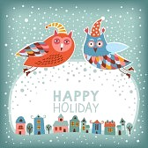
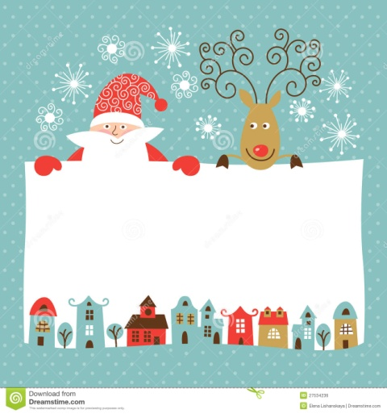
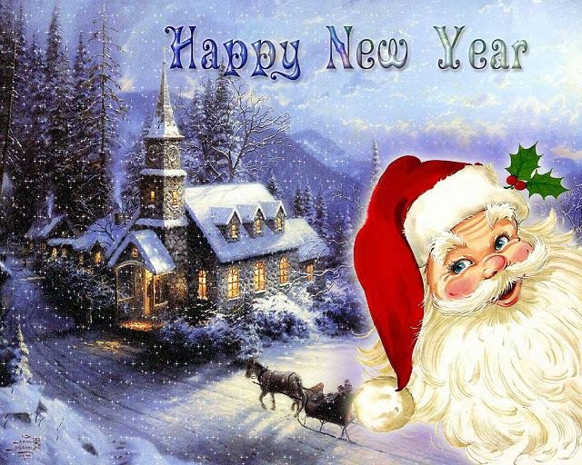
New Year Card
Happy New Year!

