Slide 1
Directions

Slide 2
Go straight on

Slide 3
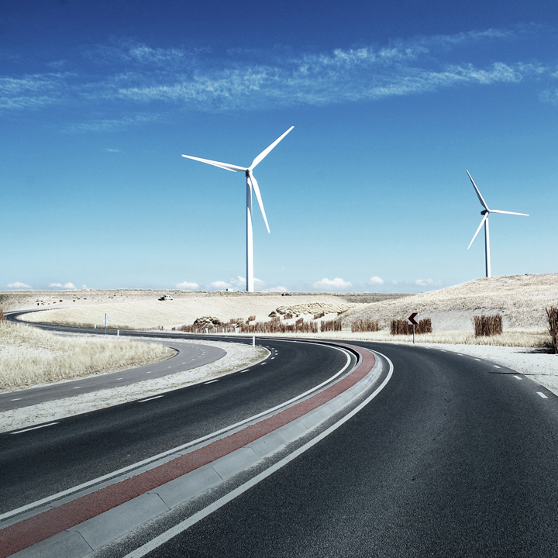
Turn left

Slide 4
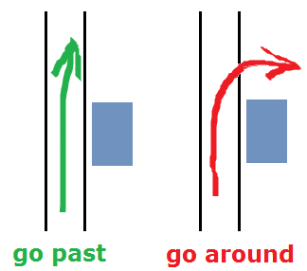

Slide 5
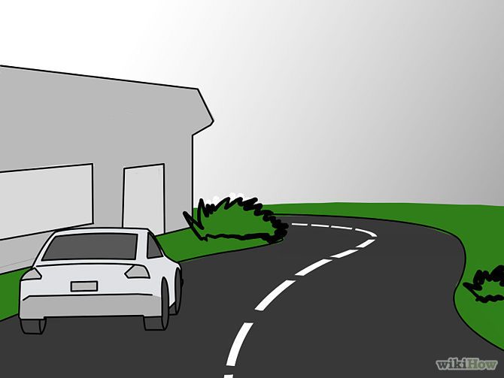
On the left

Slide 6
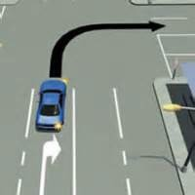
Turn right
Turn right

Slide 7
On the right

