Slide 1
Complete the story

Slide 2
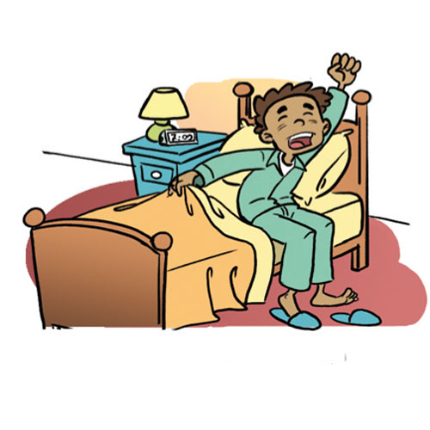
I __________ at 7 o`clock
get up

Slide 3
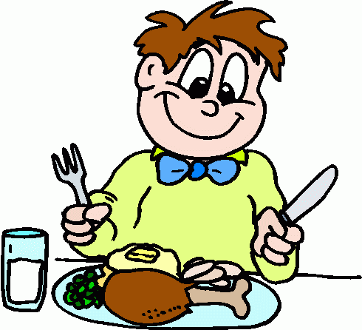
Then I _____my breakfast
eat

Slide 4
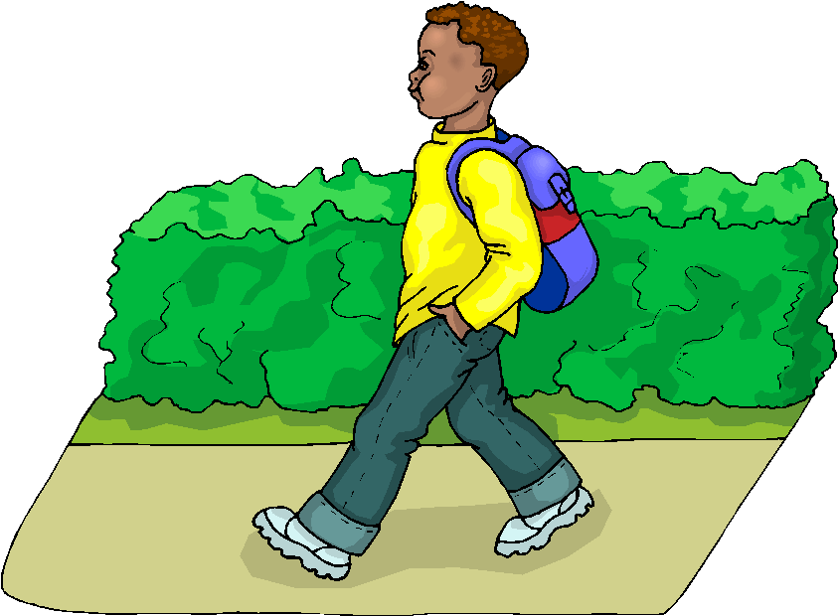
I say goodbye to Mum and _____________.
walk to school

Slide 5
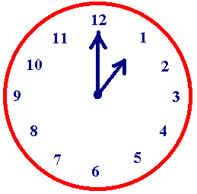
I have 5 lessons on Monday. I ____________ at 1 o`clock
finish school

Slide 6
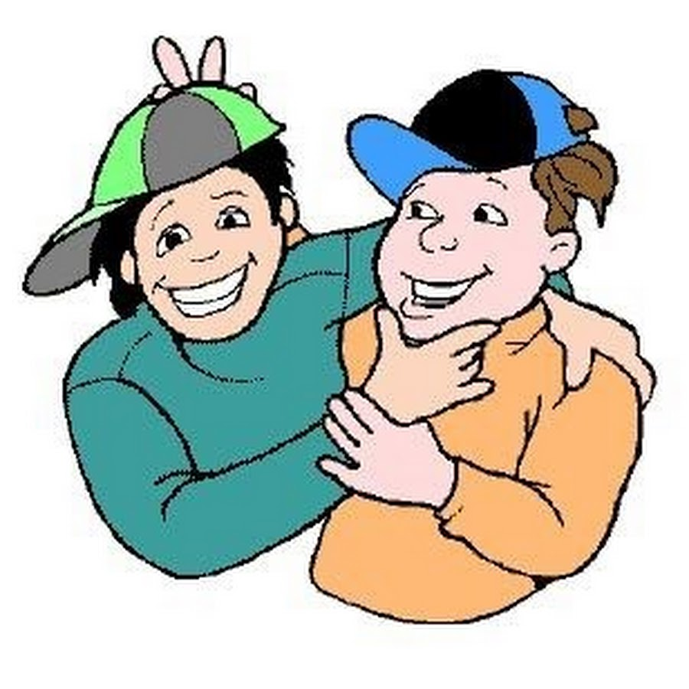
I am very tired today. That`s why I
_______________after school.
meet my friends

Slide 7
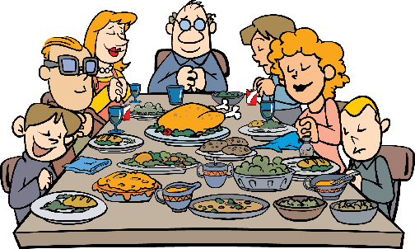
At 3 o`clock I ____________ with my family.
have dinner

Slide 8
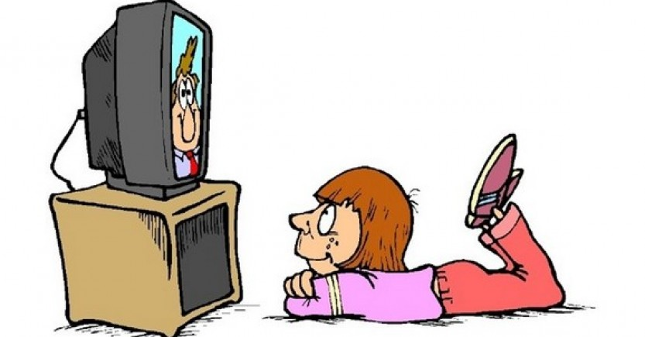
I ___________ with my dad at 5 o`clock.
watch TV

Slide 9
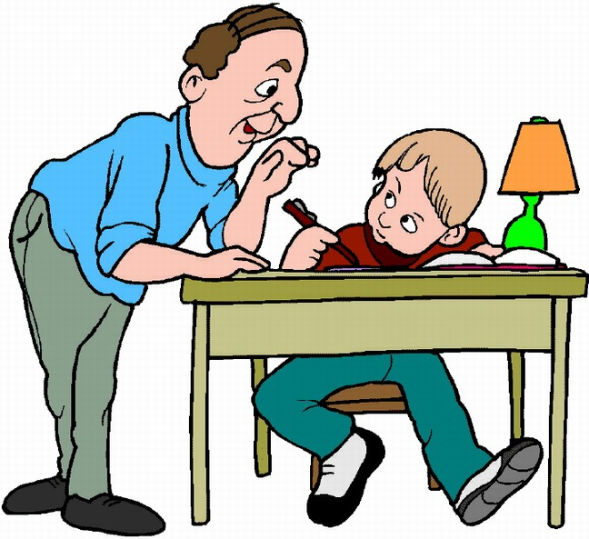
I _________________at 6 o`clock.
do my homework

Slide 10
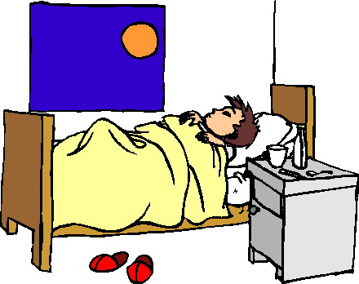
At 6 o`clock I _______________. Good night.
go to bed

